Slide 1
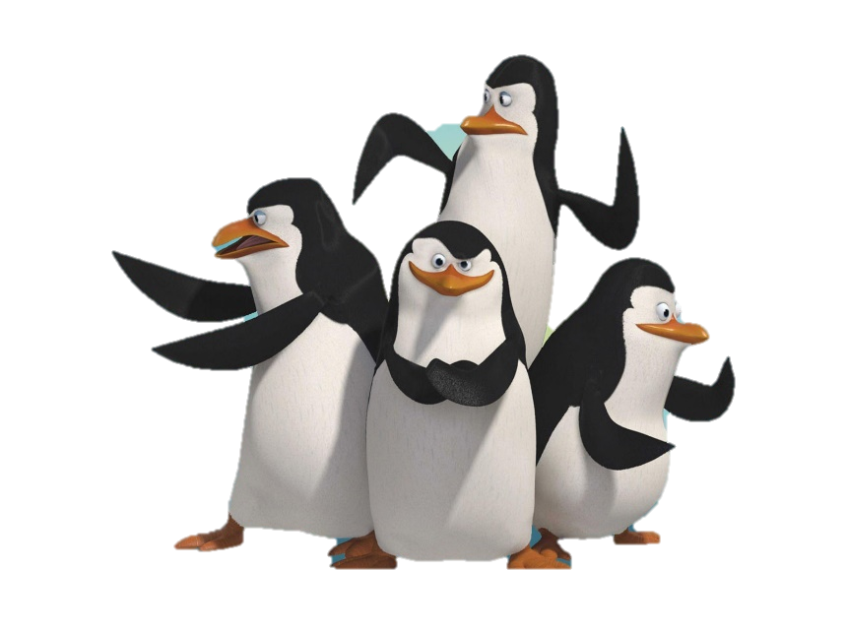
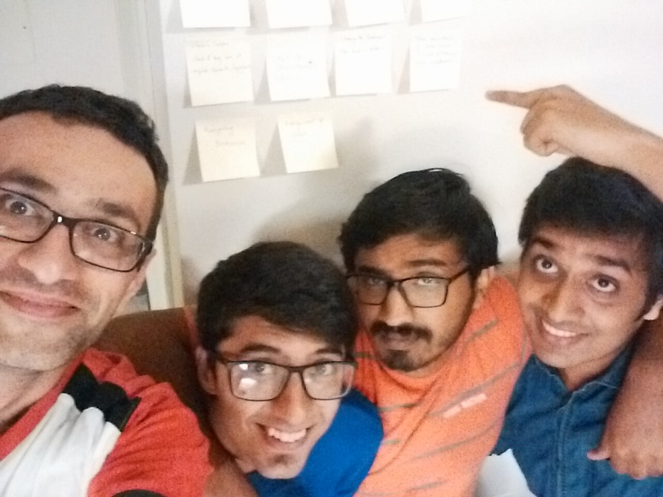
Software Development Class - IST 303 Professor Terry Ryan Gila Breath Camp 2nd Milestone
Team #Penguins:
Jemin Gohil (aka Rico)
Karthik Manjunath (aka Kowalski)
Rohan Sawant (aka Skipper)
Soheil Bouzari (aka Private)

Slide 2
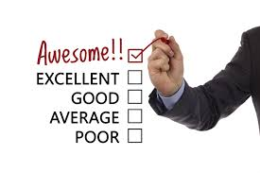

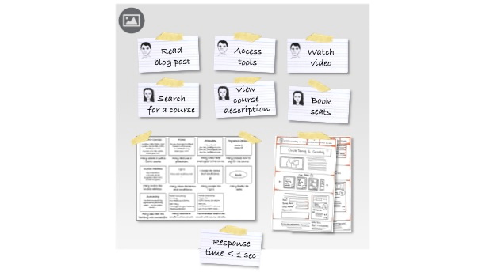
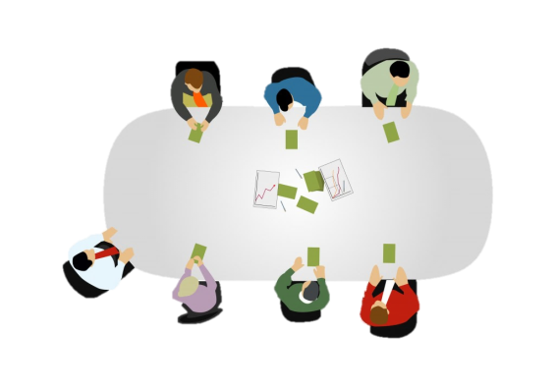

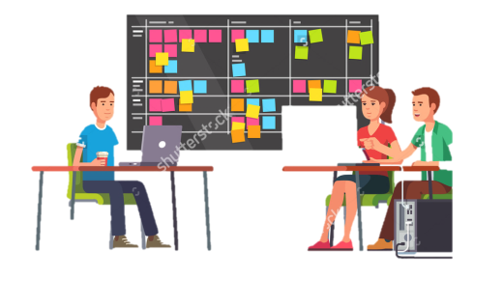
Agenda
Reviews & Take-away
from Milestone 1.0
Gathering Requirements
User Stories
Planning Poker
Estimation of project
Big Board (Initial)
Changes during Iteration
Final Big Board
Milestone 2.0

Slide 3





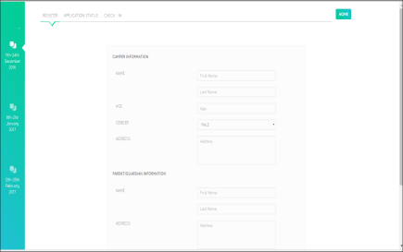
Agenda
Refactoring
SRP
DRY
Version Control
Testing
Code
Demo
Challenges & Learnings

Slide 4
1
Reviews and Takeaway from Milestone 1
• I agree with your classmates that most of what you did was quite good. In particular, you did a strong job of using tools for development and testing.
• I liked your analysis/discussion of commit history.
• I liked your analysis/discussion of refactoring.
• Excellent analysis/discussion of testing.
• The biggest weakness was probably your explanation of requirements gathering. I know that you did this well, but you didn’t explain it well.
• Next biggest weakness was the “domination” of the presentation by Rohan. I attribute this to enthusiasm, but to the class it seemed to be indicative that the other members of the group weren’t as responsible for the accomplishments. I know this is not so, but do a better job with sharing next time.

Slide 5
Summary from Milestone 1
• TEST DRIVEN DEVELOPMENT
1. Unit testing (Wrote small test. But didn’t automate much) – (python packages – unittest)
2. Functional testing (Shown for Registration. Automated fully) – (python packages – pytest)
• Deviated a lot from planned track but due to support from Customer made it up at the end
• Used HTML and javascript as front end and flat files with python Django framework
• 4 user stories – Choosing date, Registration, Application status, Check-In
• 3 iterations (Weekly iterations)

Slide 6
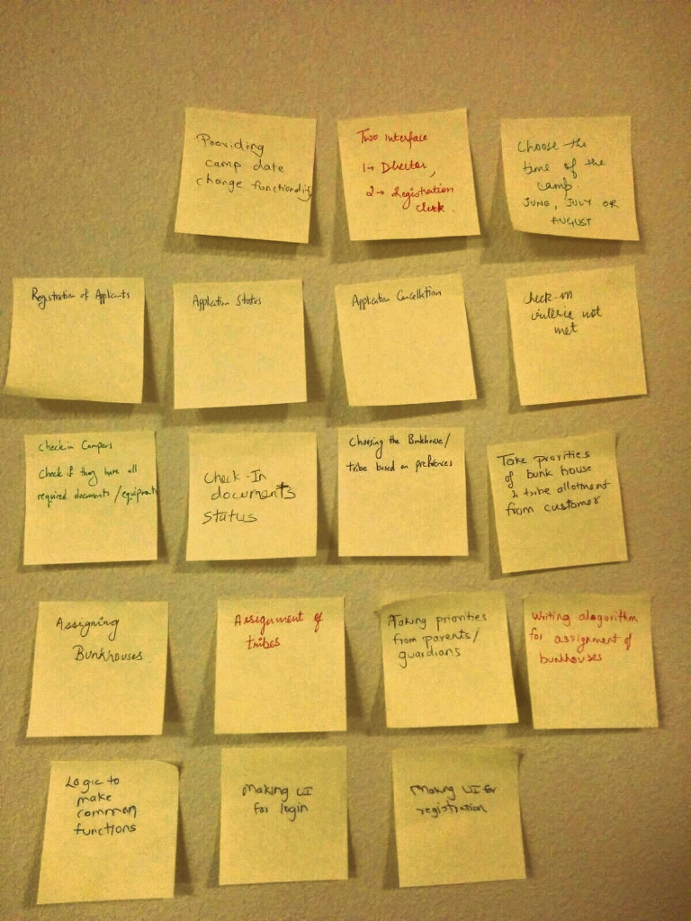
2
Gathering Requirement
Brainstorming
Blueskying
Role Playing - Asked Colleagues and friends to use
Observation
a. 1st Milestone – Other Projects
b. http://www.activecamps.com/

Slide 7
4
Planning Poker
Prioritizations | User Stories | Rohan | Jemin | Karthik | Soheil | Average
10 | Priorities from Guardian | 9.00 | 4.00 | 6.00 | 5.00 | 6.00
10 | Assignment of Bunk Houses | 8.00 | 9.00 | 10.00 | 12.00 | 10.00
10 | Assignment of Tribes | 5.00 | 10.00 | 12.00 | 14.00 | 11.00
10 | Printing of acceptance notice | 7.00 | 6.00 | 8.00 | 8.00 | 8.00
20 | Application Cancellation | 5.00 | 3.00 | 9.00 | 8.00 | 7.00
20 | Refund | 7.00 | 9.00 | 8.00 | 9.00 | 9.00
25 | Printing of non-fulfillment of request | 4.00 | 4.00 | 5.00 | 7.00 | 5.00
25 | Log In | 3.00 | 3.00 | 5.00 | 5.00 | 4.00
 | Total Sum | 39.00 | 44.00 | 57.00 | 63.00 | 51.00
Prioritization given by customer
Notes:
We did planning poker when each one provided with estimated time in days for each user story. Except for login and prin

Slide 8
4
Estimating project schedule
2nd Milestone
Printing
(New User Story derived by observing other groups)
Milestone 2.0 | Calculation
Start Day | 10/21/2016
End Day | 12/5/2016
Number of days before release (Calendar days) | 46.00
Estimated Days of Work | 51.00
Number of people in Team | 4.00
Number of workdays left (Only Week Days) | 32.00
Holidays by Developers | 0.00
Number of workdays left (Excluding Holidays) | 32.00
Velocity | 0.40
Available Work Days | 12.80
Amount of work team is likely to complete before due date | 51.00
Days of work that could be deferred | 9.00

Slide 9
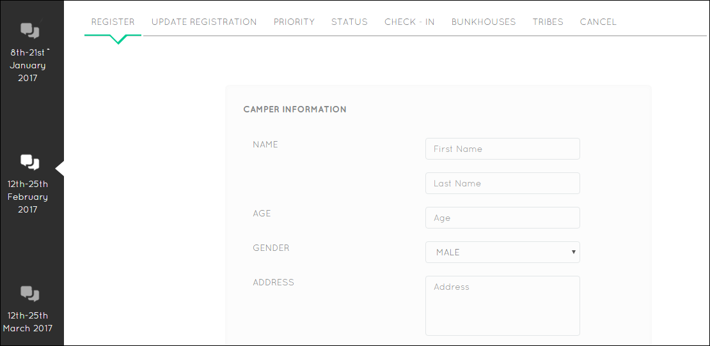
3
User Stories
1st Milestone
Notes:
I will explain you the user stories by going through the application itself .
Here we can see the choice of date could be done which was part of our User story.
Every applicant needs to register and hence we have the register User story along with a update registration user story
These were a part of 1st milestone

Slide 10
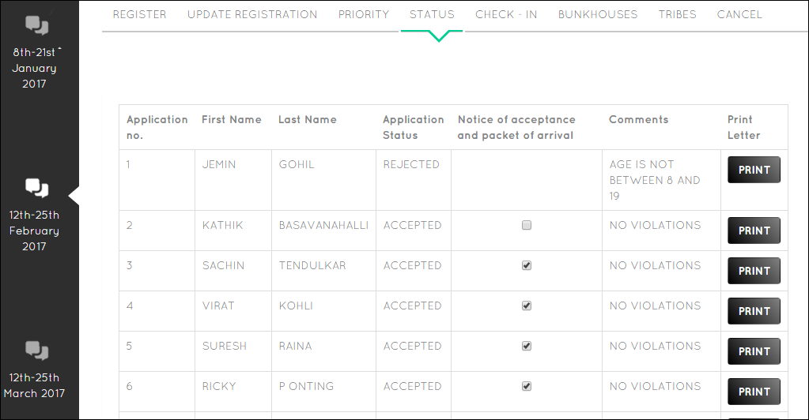
3
User Stories
2nd Milestone
Printing
(New User Story derived by observing other groups)
1st Milestone
Notes:
After registration we show the status of the of the applicant whether it is accepted or rejected along with comments if rejected.
This was part of 1st milestone.
Here we have added a new story called as printing which is a part of 2nd milestone.
This was derived by observing other groups as explained by Rohan here

Slide 11
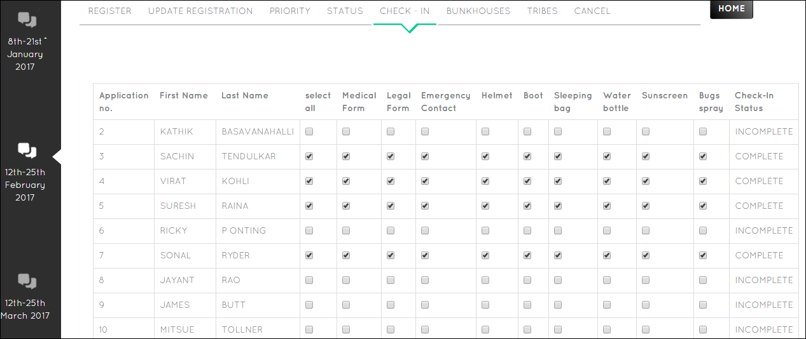
3
User Stories
Improvement made in 2nd Milestone after recommendation after Role-play with colleague
1st Milestone
Notes:
Here we shows the check-in for accepted applicants only which was the part of the 1st Milestone
Here we added Select all to increase user experience which was recommendation given by one of our colleagues after doing role play which again referred by Rohan in gathering requirement

Slide 12
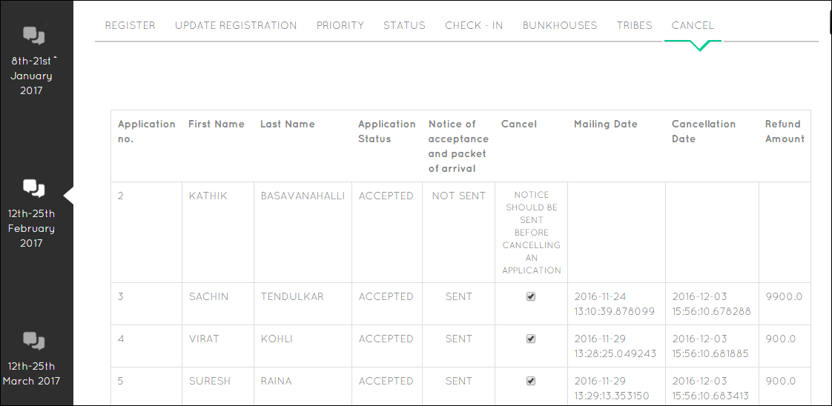
3
User Stories
2nd Milestone
Refund
Notes:
We added a new user story of cancellation only for accepted applicants. Cancellation could be done only if the notice is sent and that’s the option we have provided. Here we have also incorporated the refund amount user story.

Slide 13
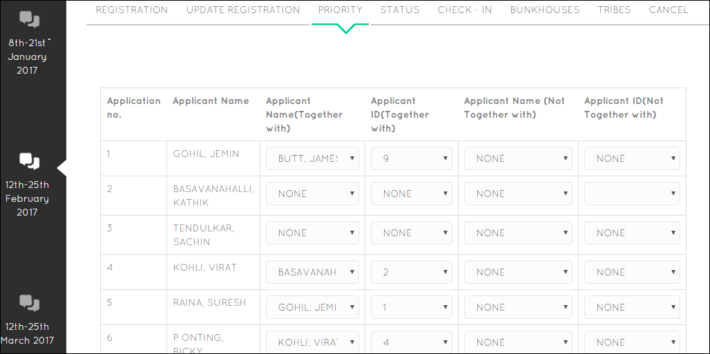
3
User Stories
2nd Milestone
Notes:
This is “taking priority” user story. Here we collect information whether the applicant wants to stay together or not together with another applicant.
This is a part of 2nd milestone

Slide 14
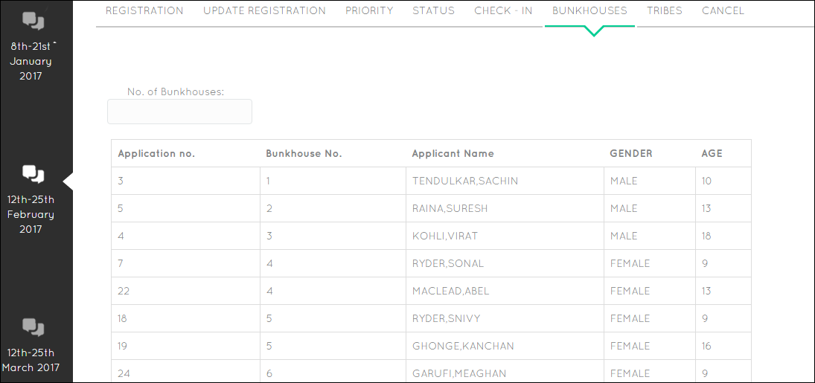
3
User Stories
2nd Milestone
Notes:
Then we come across the user story of assigning applicants to Bunkhouses. Here we could see the number of bunkhouses option which shows that number of bunkhouses could be changed dynamically

Slide 15
3
User Stories
2nd Milestone
Notes:
Then we come across the user story of assigning applicants to Bunkhouses

Slide 16
4
Big Board
User Story 1: Choosing the date
Task No. | Task | Developer | Time
1 | Making the date class (Entity) Making the CSV File | Soheil | 1 hr
2 | Making the logic of choosing the date: Connecting it to the CSV File | Rohan | 4 hrs
3 | Connecting the choosing date logic to the UI | Karthik | 3 hrs
4 | Testing the logic Testing the UI | Jemin | 1 day
5 | Common functions | Rohan | 5 hrs
User Story 2: Registration
Task No. | Task | Developer | Time
1 | Making the Applicant Class (Entity) Making the CSV File | Jemin/Soheil | 2 hrs
2 | Adding Transformations to the Applicant class | Jemin/Soheil | 4 hrs
3 | Making the logic for the Applicant class | Jemin/ | 3 hrs
4 | Making the common functions for the Applicant Class | Rohan | 5 day
5 | Connecting the Registration logic to the UI | Karthik | 3 hrs
6 | Testing the logic, Testing the UI | Jemin | 1.5 days
User Story 3: Application Status
Task No. | Tasks | Developer | Time
1 | Creating the Common functions for reading/writing/updating the application status, Making the logic | Rohan | 5 hrs
2 | Reading from the file and adding constraints for Age, Registration, Date Windows, Check Clearing | Rohan | 2 days
3 | Connecting to the UI | Karthik | 1 day
4 | Testing the logic: Testing the UI | Jemin/ Soheil | 3 days
User Story 4: Check-In
Task No. | Tasks | Developer | Time
1 | Creating the Common functions for reading/writing/updating the Check-In | Rohan | 5 hrs
2 | Making the logic for providing the CSV to the UI | Karthik | 1.5 days
3 | Connecting the read data to the UI | Karthik | 1 day
4 | Making the logic for moving data from UI to CSV | Karthik/ Rohan | 1 day
5 | Testing the UI | Jemin/ Soheil | 3.5 days

Slide 17
4
Big Board
User Story 5: Assignment to Bunkhouse
Task No. | Task | Developer | Time
1 | Making the Bunkhouse class (Entity) Making the CSV File | Jemin | 2 hrs
2 | Making the logic of Assignment to bunkhouses: Connecting it to the CSV File | Rohan | 4 hrs
3 | Connecting the bunkhouse logic to the UI | Karthik | 3 hrs
4 | Testing the logic Testing the UI | Soheil | 3 days
User Story 6: Assignment to Tribe
Task No. | Task | Developer | Time
1 | Making the Tribe Class (Entity) Making the CSV File | Soheil | 1 hrs
2 | Making the logic of Assignment to Tribes: Connecting it to the CSV File | Karthik | 3 hrs
3 | Connecting bunkhouse logic to UI | Karthik | 3 hrs
4 | Testing the logic Testing the UI | Jemin | 3 days

Slide 18
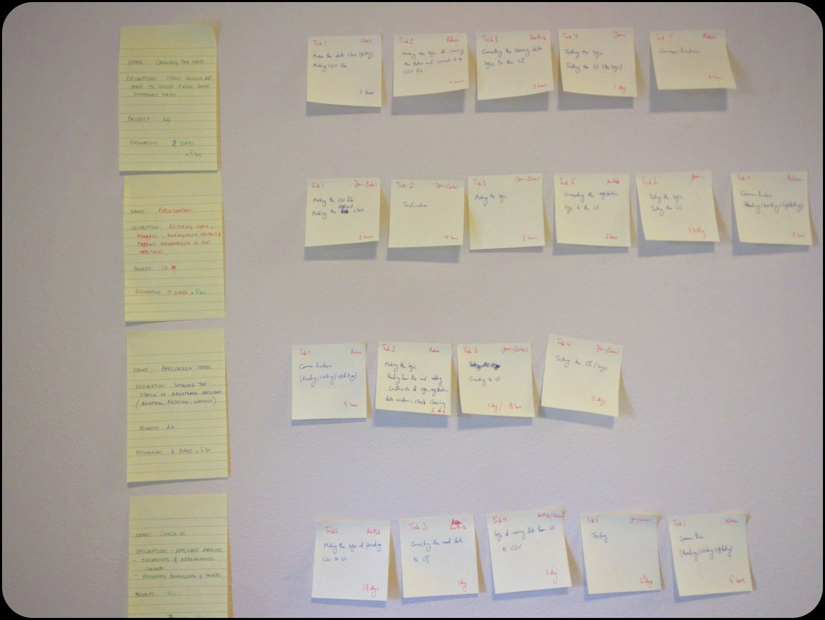
4
Big Board (Our Actual Board)

Slide 19

5
Burn Down Chart (Iteration 3)
We are not on track

Slide 20

5
Burn Down Chart (Milestone 1)
We are on track

Slide 21


6
Milestone 2.0
User story 4:
Application Cancellation
Description: cancellation of application.
User story 5:
Refund
Description: Refund amount based on cancellation date.
User story 10:
Maintenance
Description : ???.
User story 7:
Assignment to Bunkhouses
Description : based on various factors.
User story 8:
Assignment to Tribes
Description : based on various factors.

Slide 22
7
Continuous Integration: Version Control
As GitHub is easily accessible to all and we wanted a more secure version control tool for our code, so we shifted from GitHub to BitBucket.
Link: https://bitbucket.org/Rohan9969/software_development_cgu/overview
Git commands:
gitclone https://Rohan9969@bitbucket.org/Rohan9969/software_development_cgu.git
git pull
git add .
git commit –a –s
git push origin master
Merge conflicts:
git checkout <files creating conflict>

Slide 23
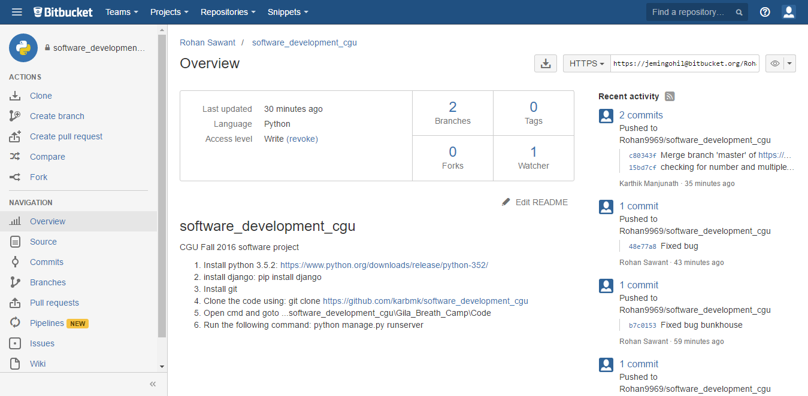
7
Version Control

Slide 24
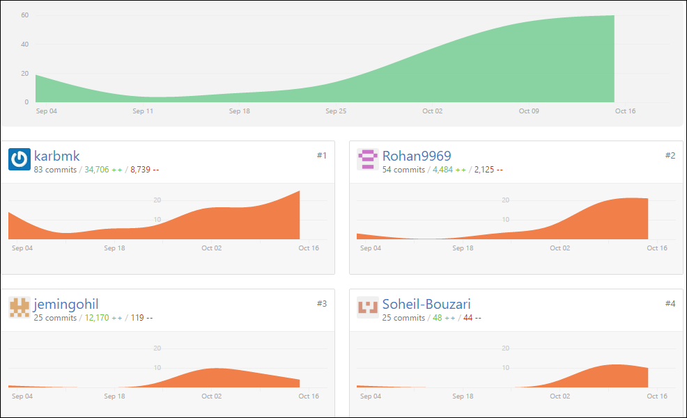
7
Version Control
80% of the work done in 20% of the time.. So much true for whole project and each individual as well
Start date 4th Sept 2016
83 commits by me ☺

Slide 25
8
Refactoring : SRP

Slide 26
8
Refactoring : DRY
Creating a Common File for read/write/update/increment user id

Slide 27
9
Test-Driven Development
Black-box testing
Grey-box testing
White-box testing

Slide 28
9
Test-Driven Development
Unit Test
PY Test
Functional Test

Slide 29
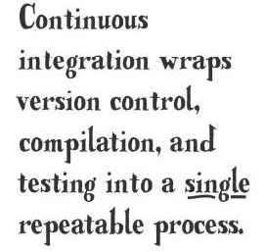
9
Test-Driven Development
Automated Building
Automated testing

Slide 30
9
Bugs

Slide 31
10
Code and UI
Lets got to UI and check it out

Slide 32
11
Challenges
1. Everyone:
a. Estimation of time for user stories
b. Making data for our testing
c. Balancing of workload
2. Rohan/Karthik: Understanding the testing module – unittest
3. Soheil: Balance the workload with other courses – Understanding
Some actual project coding standards
4. Jemin: Understanding the software development practices in actual running application

Slide 33


Slide 34
REFERENCES
http://www.thehealthcarepeople.com/2015/02/16/top-three-challenges-healthcare-professionals-physicians/
https://docs.python.org/2/library/unittest.html
https://www.djangoproject.com/
https://docs.python.org/2/howto/webservers.html
http://stackoverflow.com/questions/5788521/reading-a-csv-file-using-python
https://guides.github.com/activities/hello-world/
http://lifehacker.com/5983680/how-the-heck-do-i-use-github
https://www.python.org/about/success/

